Slide 1


How robots move – Navigation, Motion planning and Manipulation

Slide 2
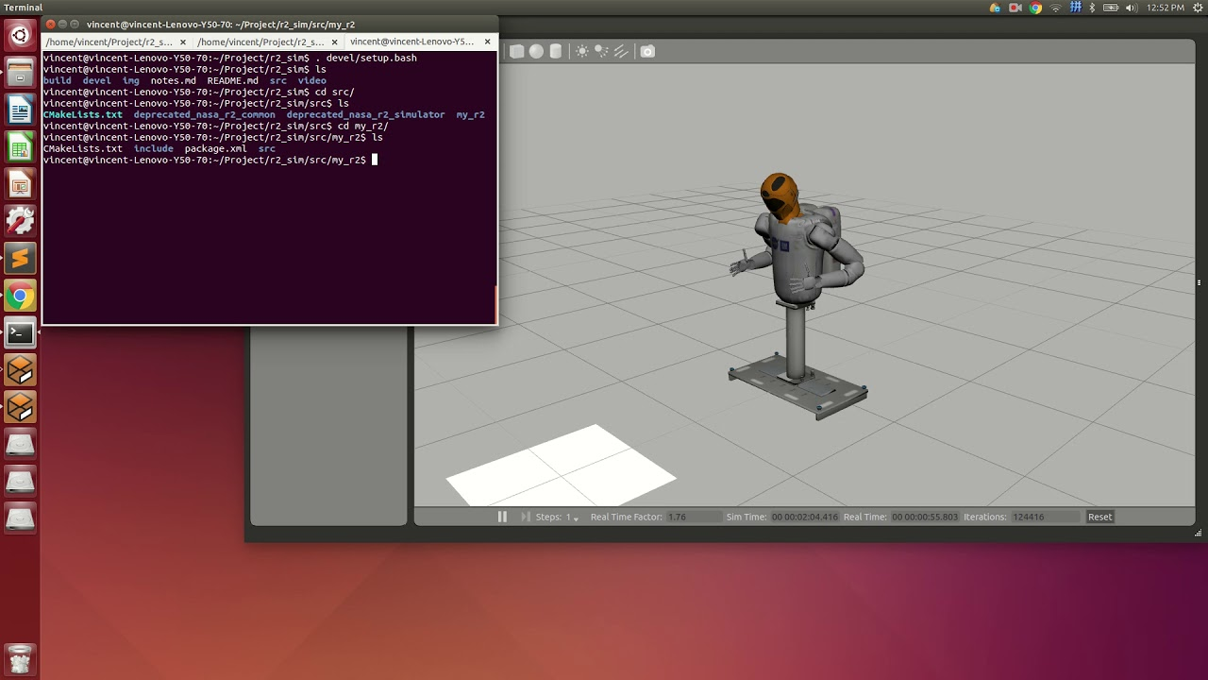

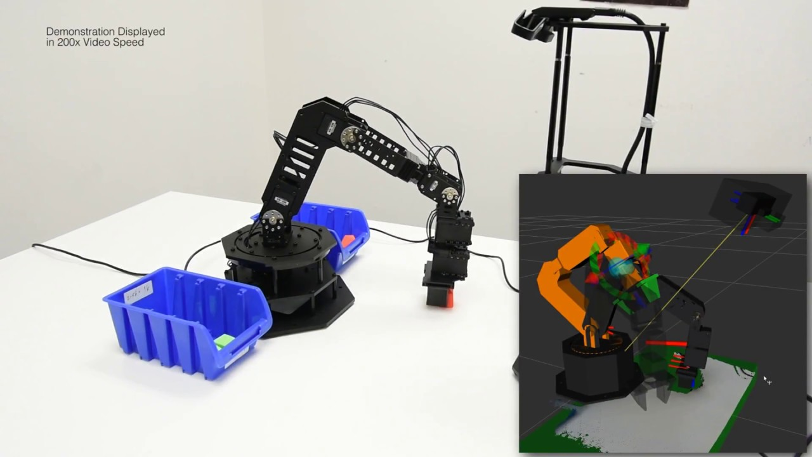
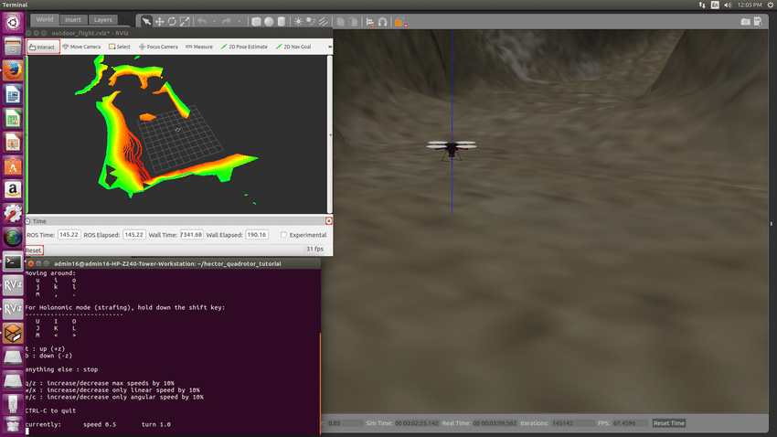

Slide 3
What is ROS
NOT an Operating System
Middleware
Set of libraries
Meta-operating system
Collection of software frameworks
Abstraction from hardware

Slide 4
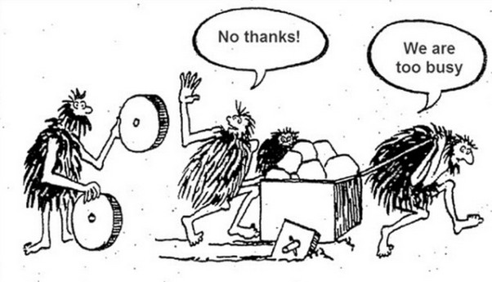
Why ROS?

Slide 5
Usual approach
Write all the programs
Define a way of communicating between them
Write 3D simulation softwares
Implement all the robots

Slide 6
What ROS offers
The middleware core
A set of libraries
Compatible 3D visualization and simulation tools
Open-source community support
Tools and libraries made for ROS – MoveIt, Gazebo
Additional services like rosbridge, and popular stacks

Slide 7
Should YOU use ROS?
Overkill for small projects
Very Useful when the number of sensors and actuators increase
Essential when anything remotely complex is needed to be done
Perfect for robotics research
Good for prototyping but look for other options too

Slide 8



ROS Versions
http://wiki.ros.org/Distributions

Slide 9
Let’s shift to ROS irl

Slide 10

Let’s get those things in order first

Slide 11

What you need to think about
How do you describe where is a robot?
How do you represent a body in space?
How many parameters you’ll need to have to represent a robot?
How does the robot know where it has to go?
How does the robot plan its motion – the path it will take, the speed it will go ahead with, etc.
How will the robot do what it is supposed to do?

Slide 12
Words you’ll often hear - common robotics terminology
Degrees of Freedom
End effector
Payload
Actuator
Joint
Link
Constraint
Modeling

Slide 13
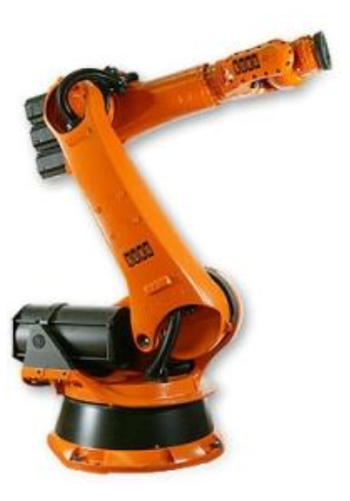
How Many joints and links are there?

Slide 14
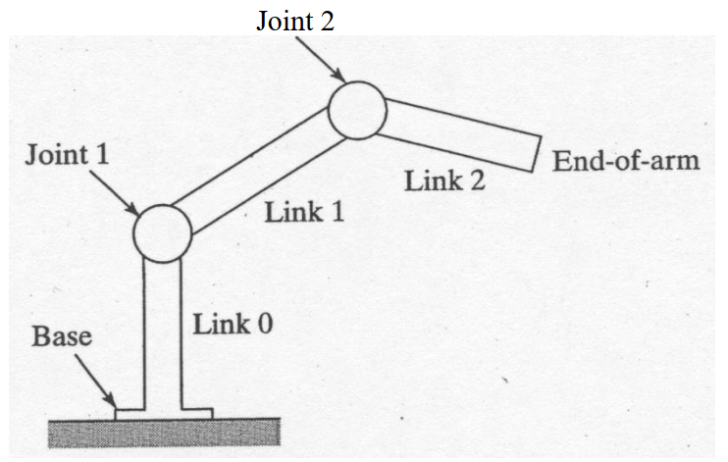

Slide 15
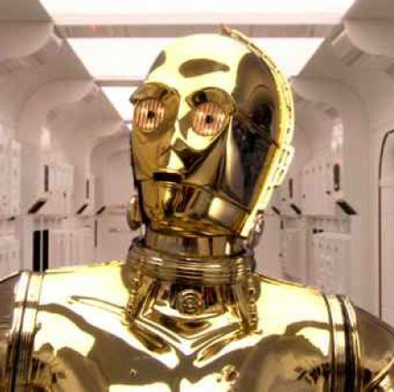
Problem 1 – Where is my robot
Configuration
Configuration Space
Degrees of Freedom

Slide 16
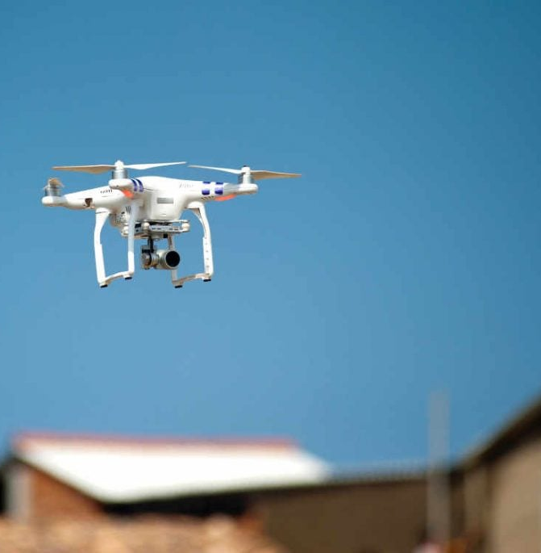
Configuration
A specification of the position of all points of a robot (cartesian coordinate, cylindrical, spherical, articulated)
How many parameters you would need to describe a body in space? (We only talk about rigid bodies)

Slide 17
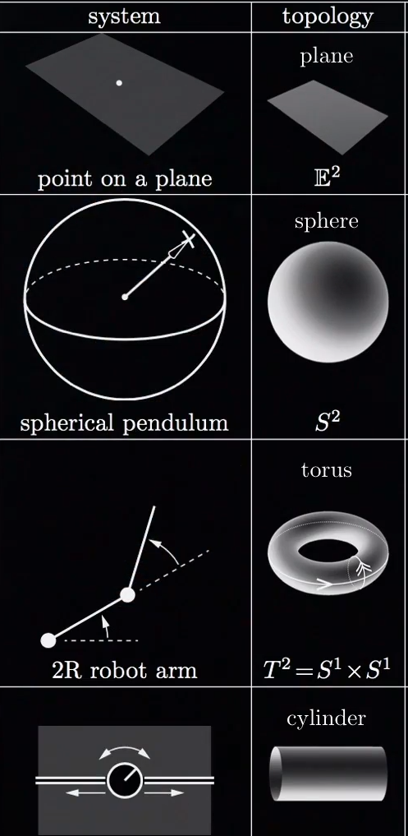
Configuration space (C-Space)
The space of all configurations
C-Spaces have topologies – plane, sphere, torus, cylinder
Two types of representation for curved configuration spaces – implicit representation and explicit parametrization (minimum number of coordinates)
Implicit representation is much more popular – rotation matrices, no time derivatives, just a surface embedded in a higher-dimensional space

Slide 18
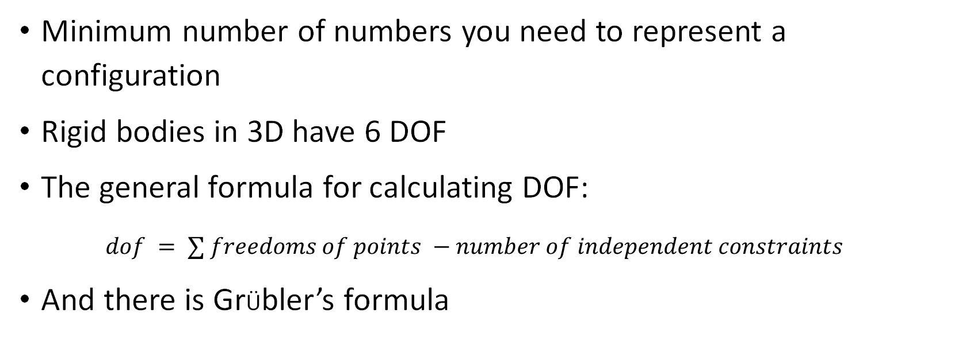
Degrees of freedom
Minimum number of numbers you need to represent a configuration
Rigid bodies in 3D have 6 DOF
The general formula for calculating DOF:
$dof = ∑ freedoms of points −number of independent constraints$
And there is GrÜbler’s formula

Slide 19
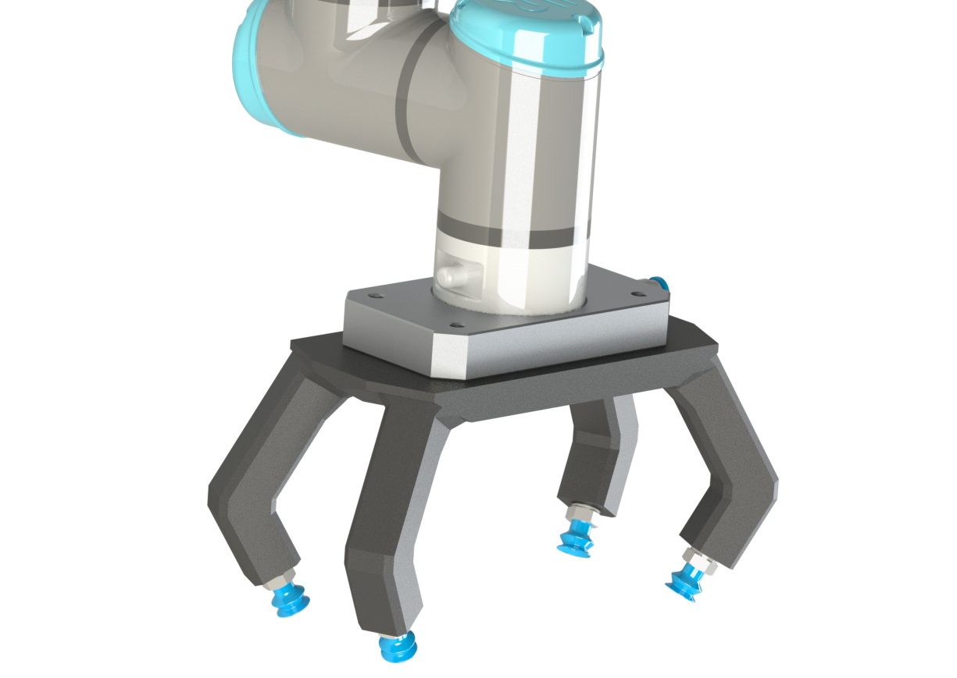

Problem 2 – Going from one point to another

Slide 20
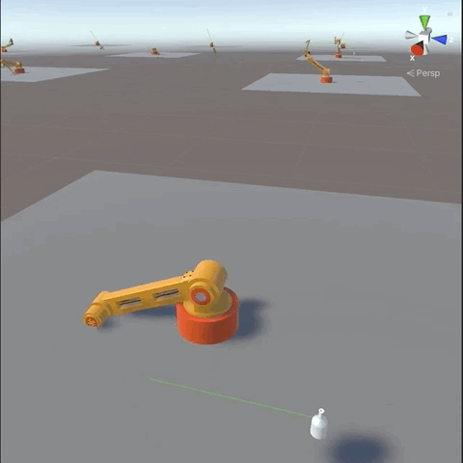
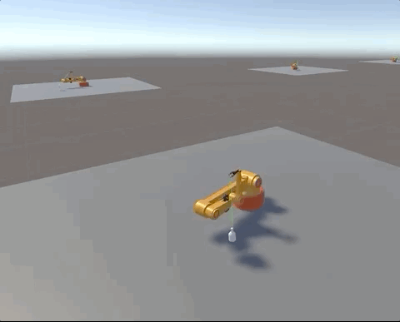
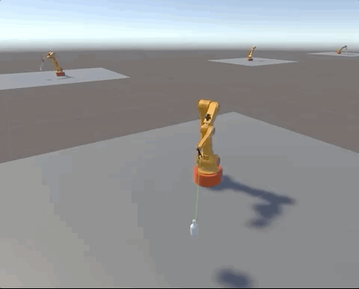
lEtS uSe aI

Slide 21
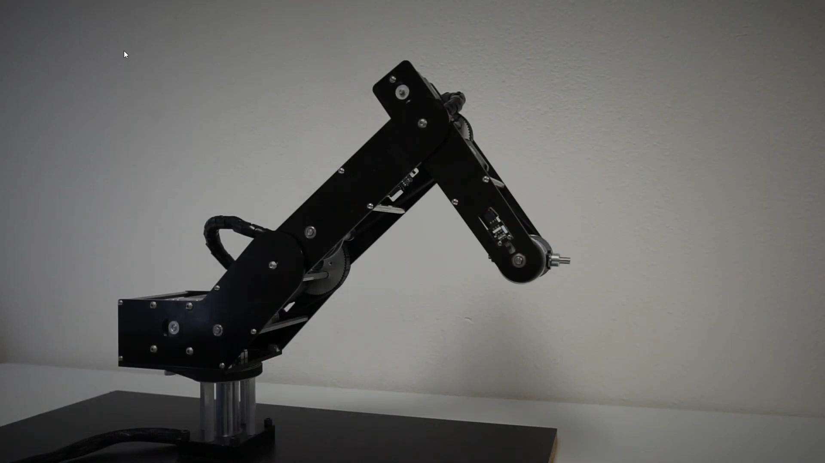

Slide 22
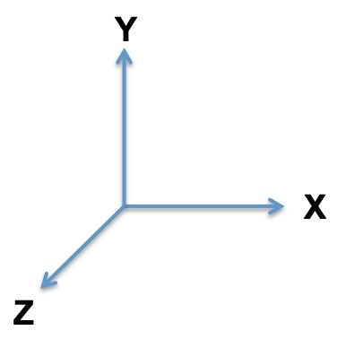
F1
F2

Slide 23
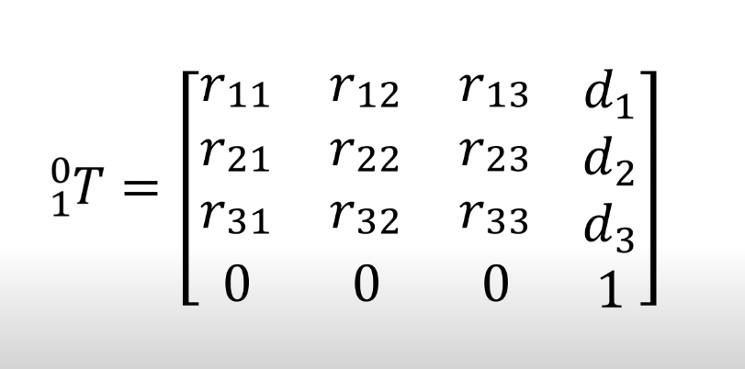
Transformation Matrix
Why 0s and 1?

Slide 24
Principle movements
Rotations
Rotation along X axis
Rotation along Y axis
Rotation along Z axis
Translations
Translation along X axis
Translation along Y axis
Translation along Z axis

Slide 25
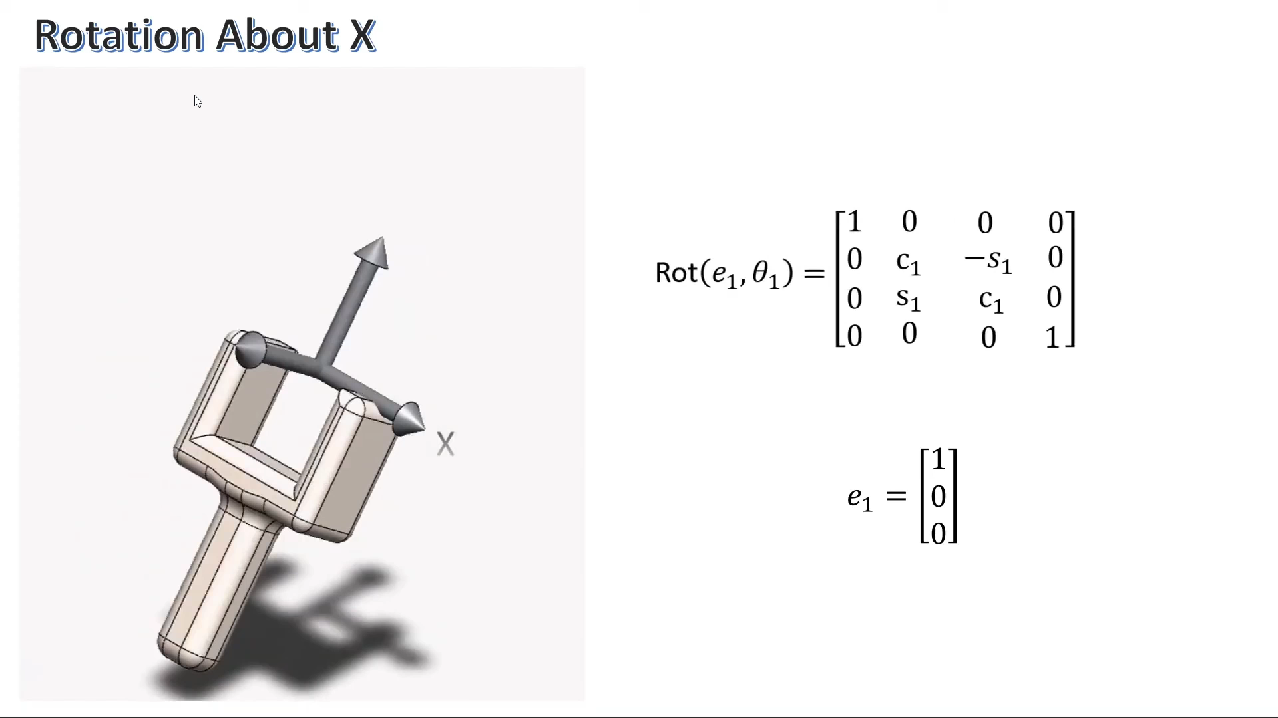
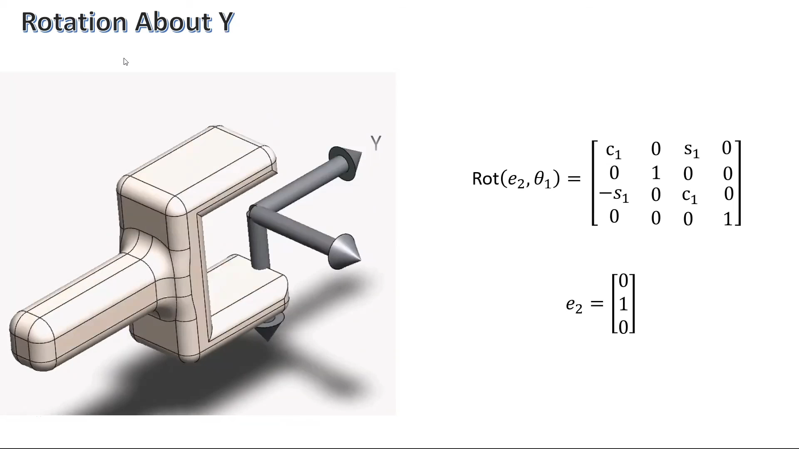
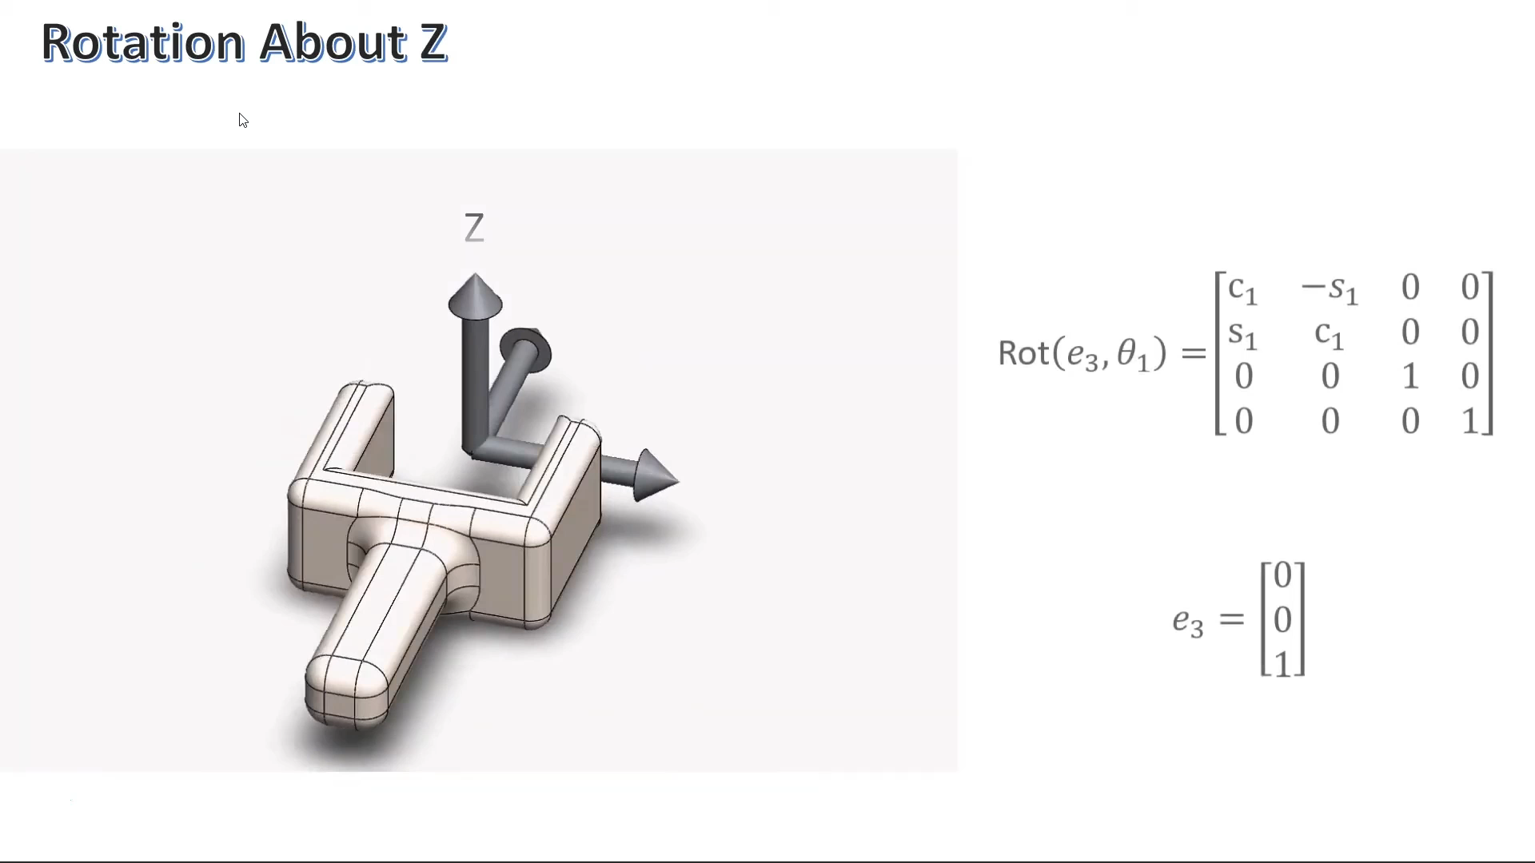
The rotations

Slide 26
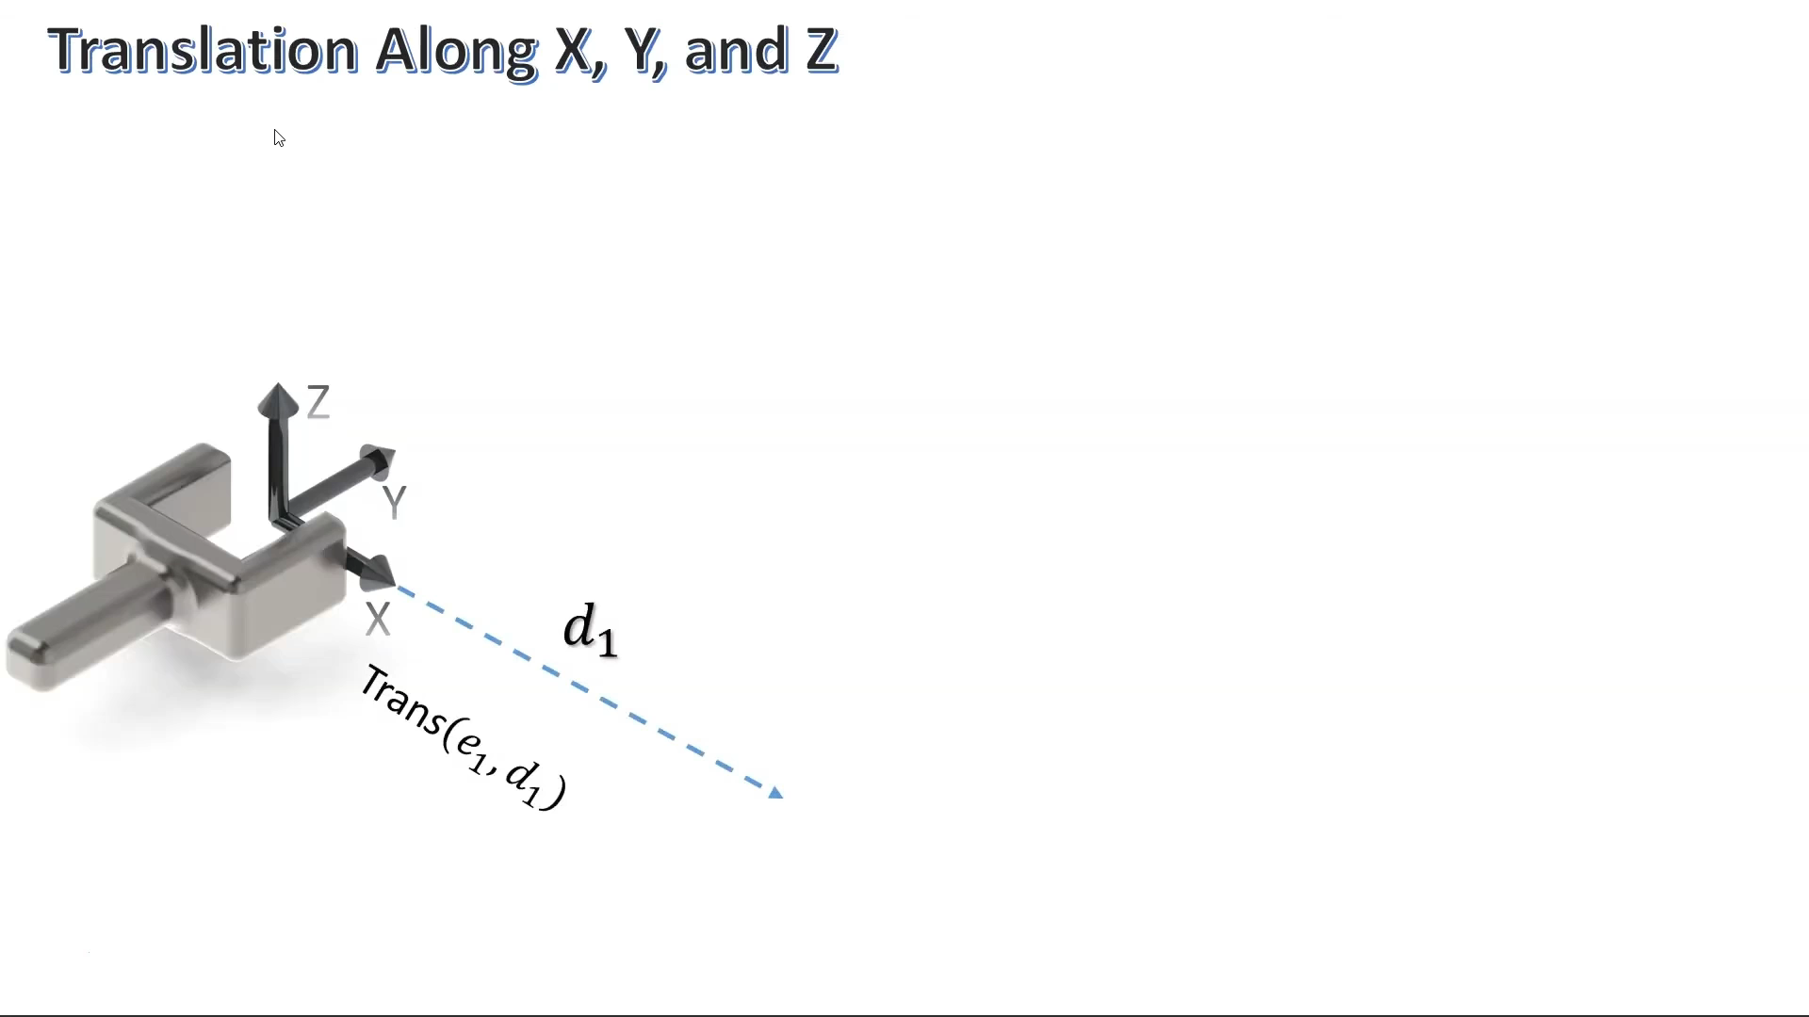
The Translations

Slide 27
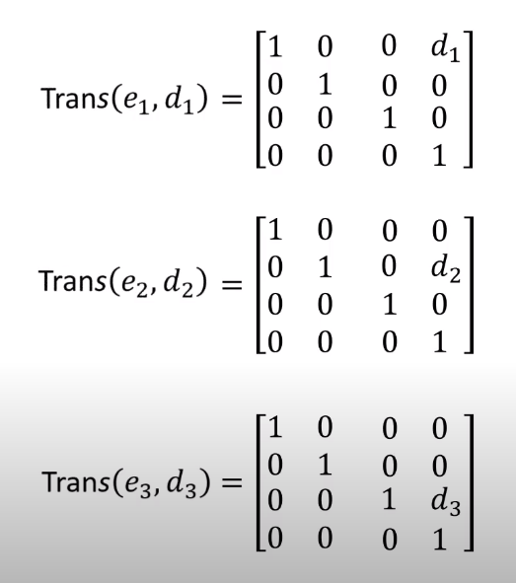
Translation matrices

Slide 28
Every possible movement is a combination
F1
F2
What’s the transformation matrix?

Slide 29
Three things that can be done using transformation matrices:
Represent a configuration
Change reference frame
Displace a vector or frame

Slide 30
Overview of ROS

Slide 31

Problem 3 – How does the robot plan its movement?
Motion Planning

Slide 32
Why motion planning?

Slide 33
Why motion planning?
There might be obstacles in the environment
Higher degree of freedom = Larger number of approaches to reach the same goal position
Not every approach has the same energy requirements
There might be design or operation constraints

Slide 34
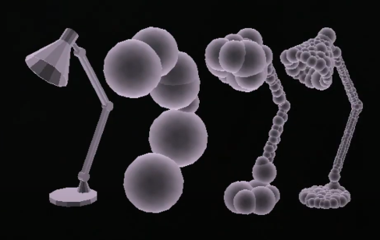
Going back to Configuration Space
C-Space: C = C(free) + C(obstacles)
Obstacles = set of points in the C Space

Slide 35
Types of path planning algorithms
Trajectories and paths
Fully actuated and underactuated
Offline and real time
Exact and approximate

Slide 36
Properties of Motion Planning algorithms
Computational complexity
Multiple query vs single query
Completeness
Resolution completeness (discretization)
Probabilistic completeness (planning times -> infinity => probability finding a solution -> 100%)

Slide 37
Popular path planning algorithms
DFS and BFS
Dijkastra’s Algorithm
A* Algorithm
Optimization of these (Lifelong A*, D*, variations of Anytime algorithms)

Slide 38
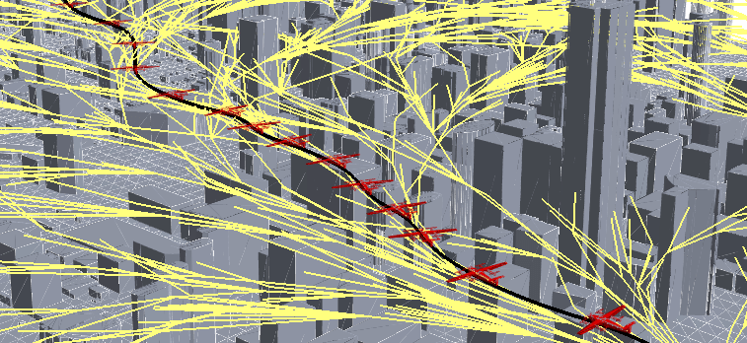
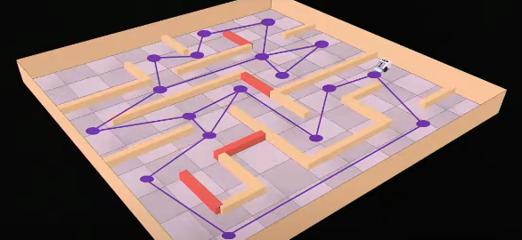
Trees and Graphs
Motion planning is often done in discretized manner
There are nodes and edges
More often than not weighted
directed graphs are used
Trees are used with sampling based methods

Slide 39
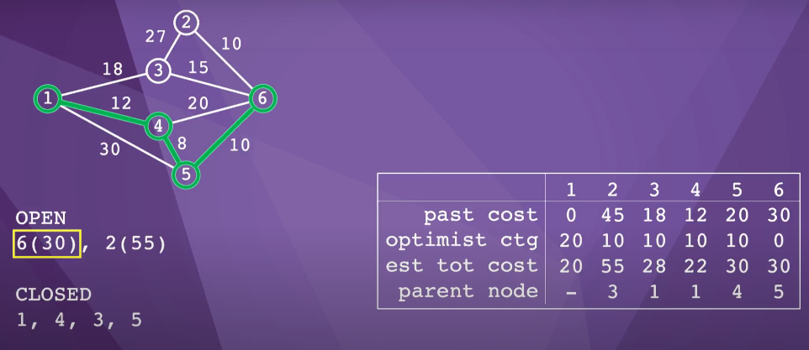
A* Algorithm
Graph search algorithm
https://clementmihailescu.github.io/Pathfinding-Visualizer/

Slide 40
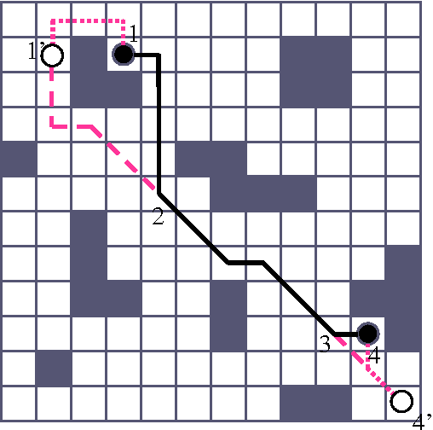
Grid Methods
Dividing the C-Space into grids
Not very efficient
Optimizations done in 3D
Resolution complete

Slide 41
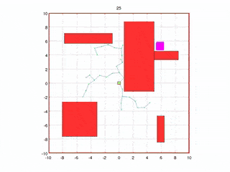
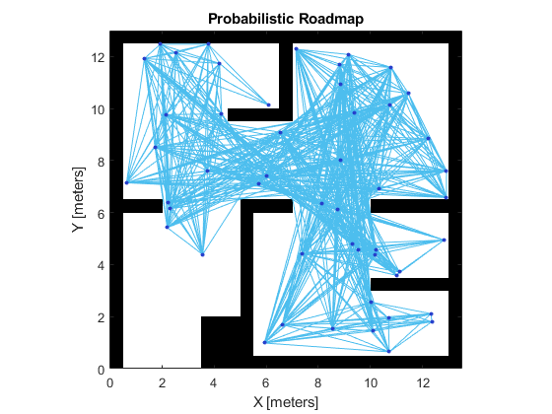
Sampling based methods
Probabilistic methods
Tree-based
Popular approaches –
Probabilistic Roadmap (PRM)
Rapidly Exploring Random Tree (RRT) and RRT*

Slide 42
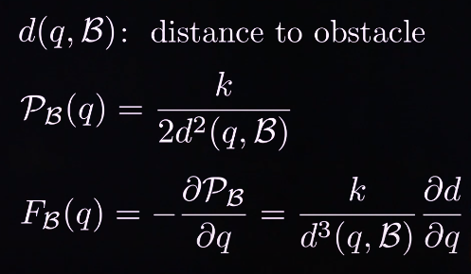
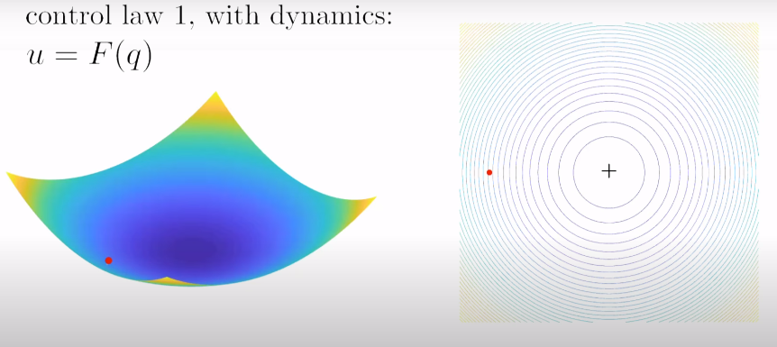
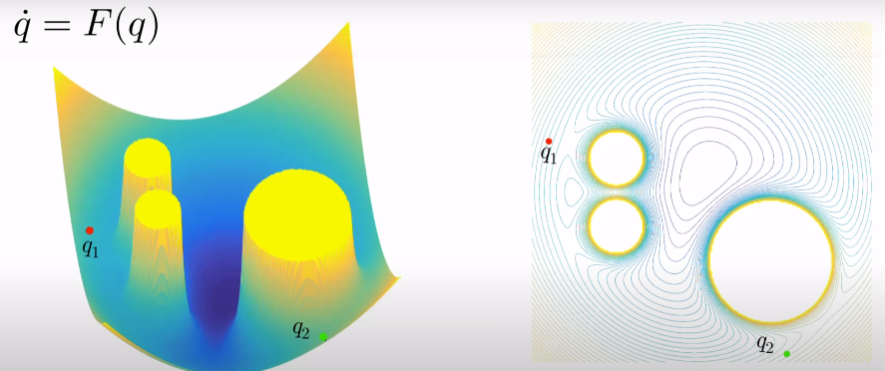
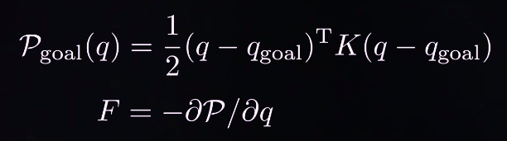
Virtual Potential Fields
Robots supposed to be attracted or repulsed by an artificial potential field

Slide 43
Optimization and newer developments
Non-linear optimization
Saptiotemporal LSTM Nets based learning algorithms

Slide 44

How does the robot do what it is supposed to?
Manipulation

Slide 45
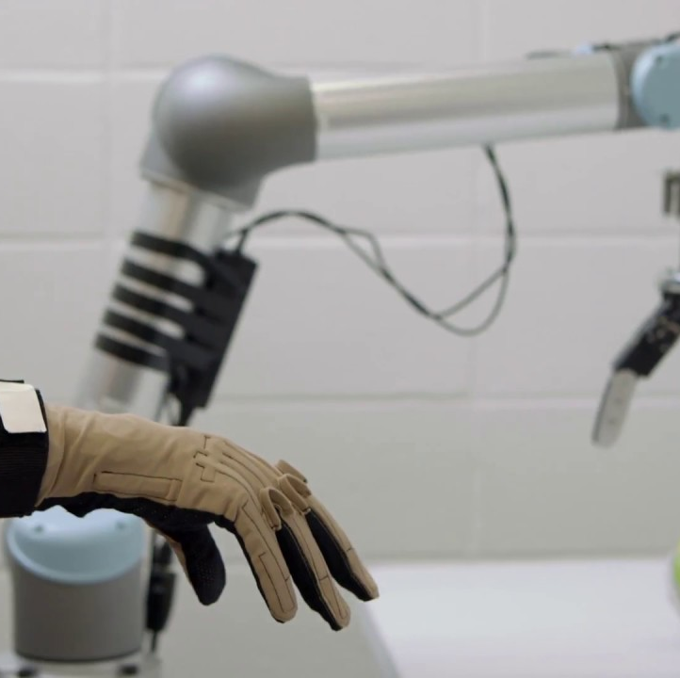
Robotic Manipulation
Changing the state of an environment to a desired one

Slide 46
Simulation of Manipulation
Not trivial
Must incorporate feedback control and perception
Must replicate the environment to the max
https://colab.research.google.com/github/RussTedrake/manipulation/blob/master/intro.ipynb#scrollTo=C1sdq2R88C16
https://colab.research.google.com/github/RussTedrake/manipulation/blob/master/intro.ipynb#scrollTo=4cTkwpJU8tGX

Slide 47
Thank You

